Slide 1

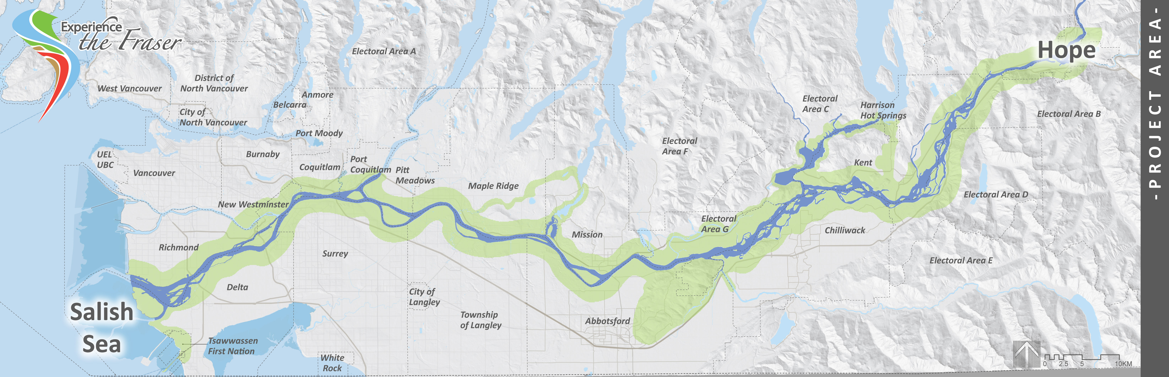
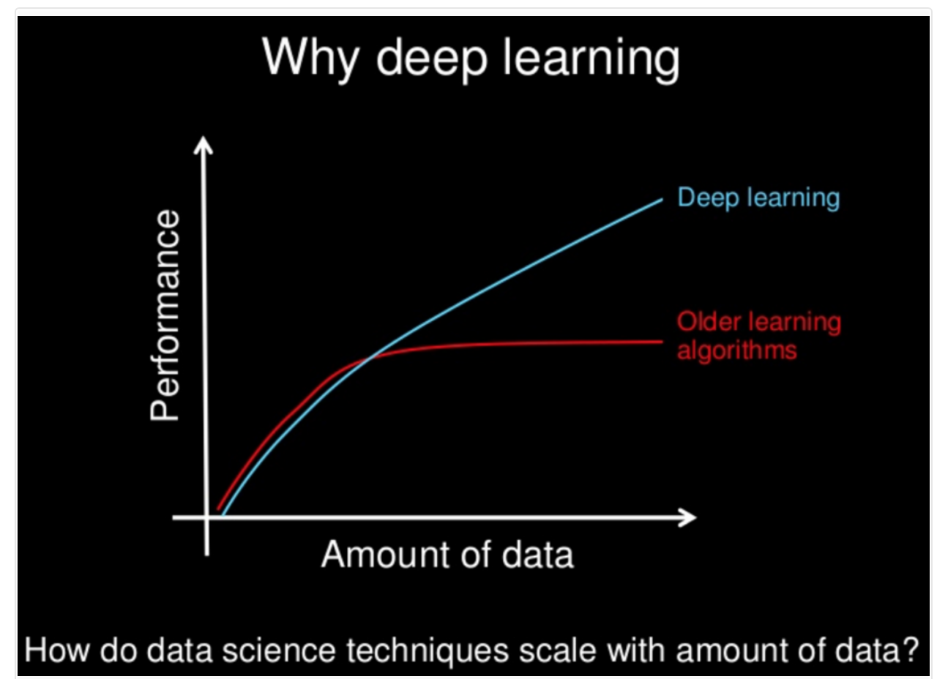
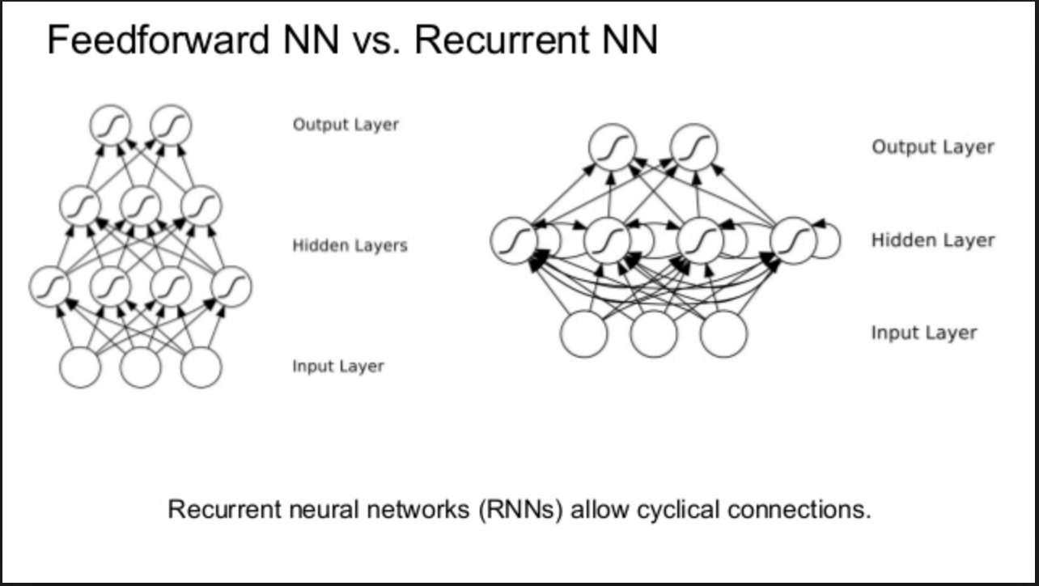
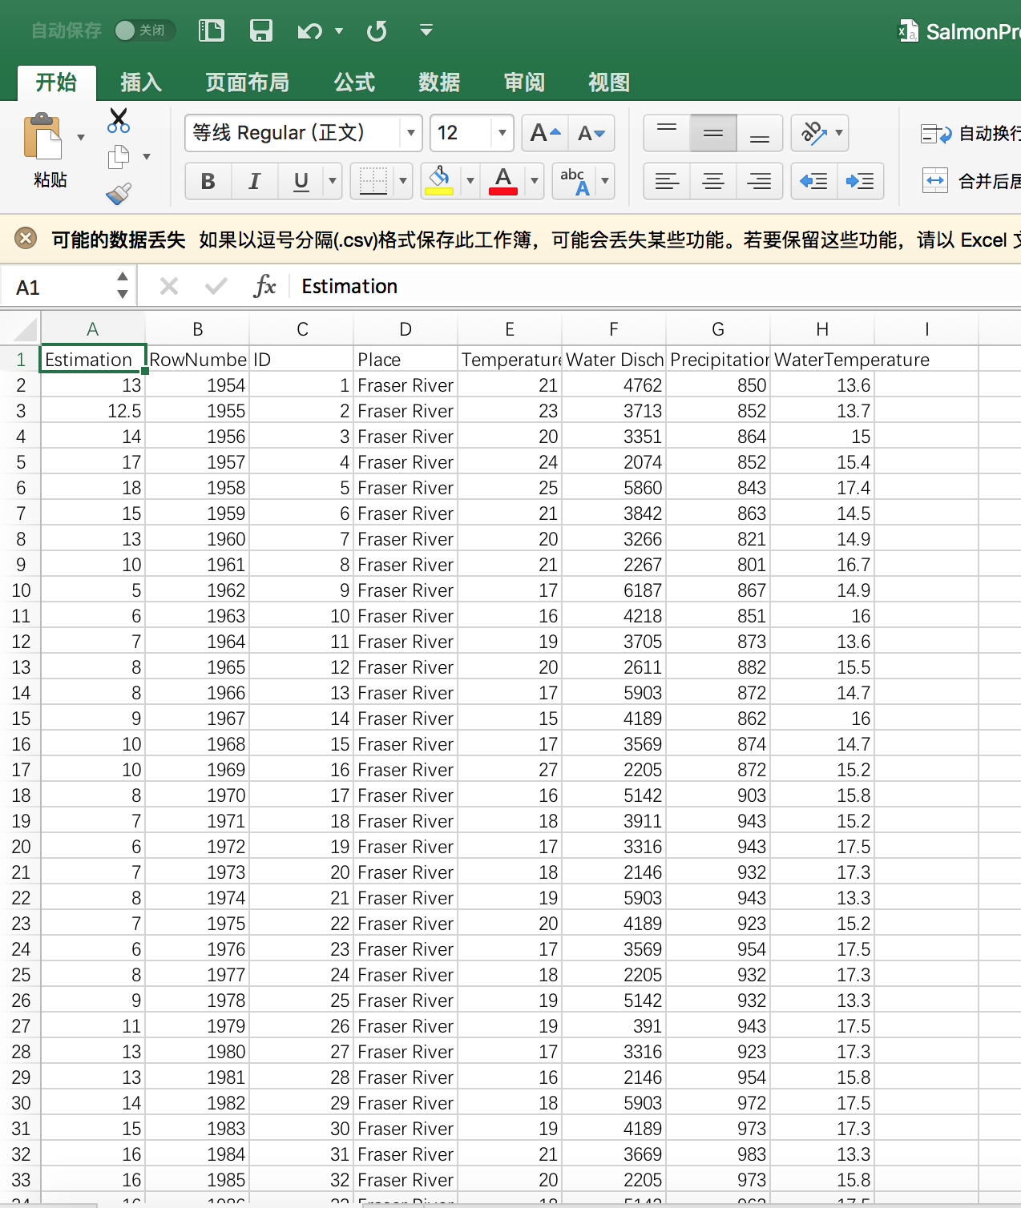
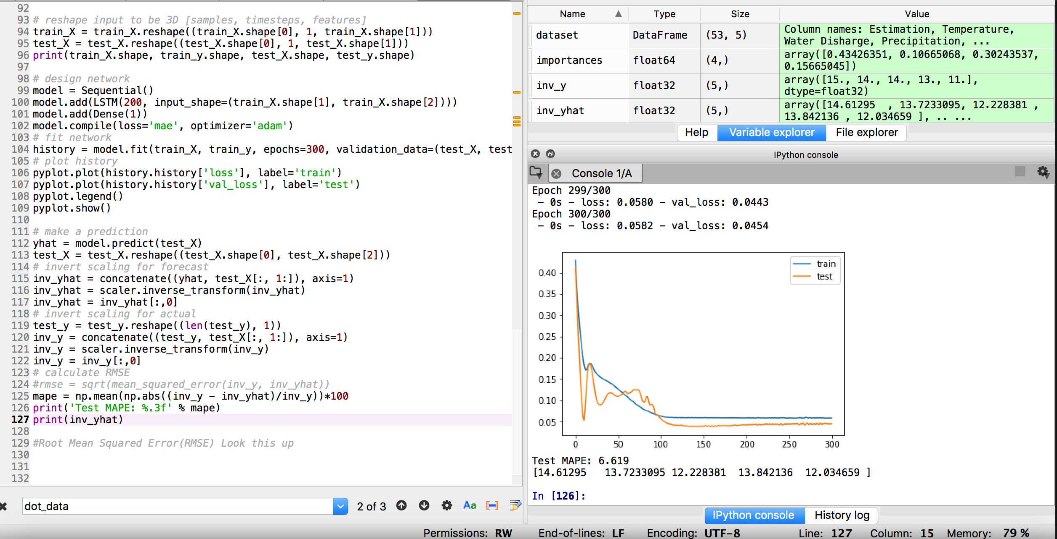
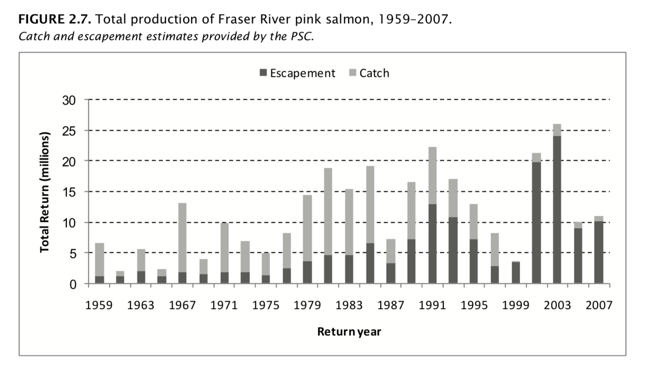
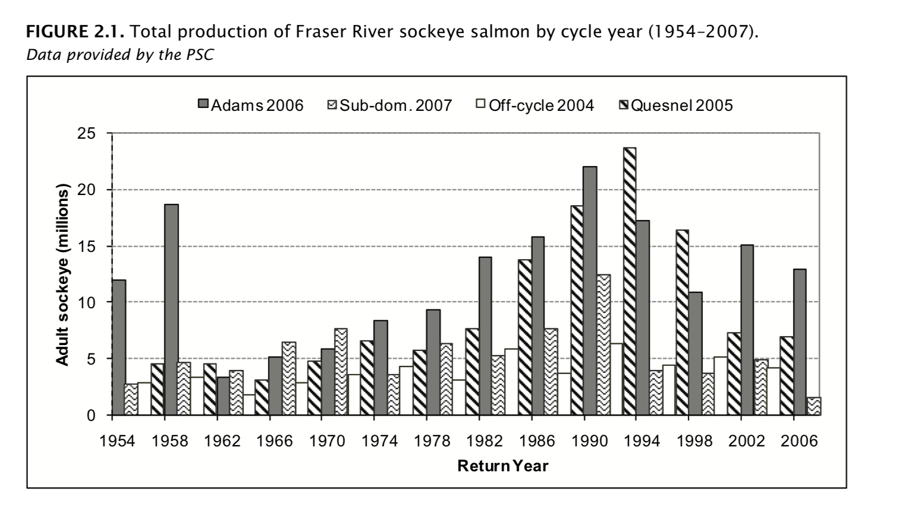
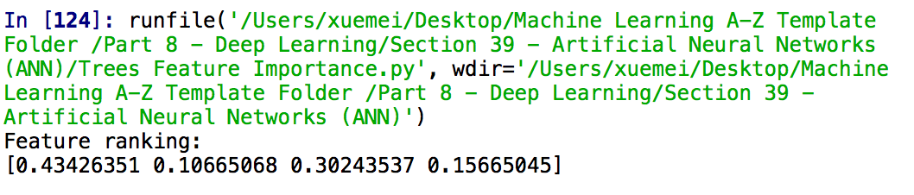
A Recurrent Neural Network software that analyzes different variables in the environment to predict salmon spawning and provide data visualization
Introduction
The Deep Learning algorithm and its Performance
RESULTS
The software that is created to solve this problem is a statistical analysis software that uses machine learning to analyze the relationship between variables and predict salmon spawning. In the current market, there are many softwares that are designed to be utilized by companies with huge data sets. Due to the complexity of the statistical analysis softwares, these softwares are not useful to students who are trying to understand the environment. In addition, the current statistical analysis apps are not specific to analyzing and predicting the salmon population. Therefore, even if students could use the current statistical analysis software, they would not get an accurate prediction of salmon spawning.
The environmental statistical analysis software I'm creating differs from the previous statistical analysis applications. The interface consists of a csv file that includes variables of the environment including river temperature, river level, and precipitation. On the other hand, the output of the software would be the amount of salmon spawning.
This software includes a database that is able to be compared with the data that is inputted by a user. This feature saves valuable time, because users normally have to enter data into their own database. The database contains variables such as temperature, precipitation, salmon population and river levels from previous years in the Chekamus region. When a user inputs the current temperature, precipitation, and river level. The software gives a prediction of the amount of salmon spawning. More importantly, it shows the trend of the temperature from past data, explaining to people the meaning of the inputted data. A cool feature of this software is the correlation coefficient (r). For example, we often say that the number of salmon is related to temperature, river level and precipitation. The database which contains the number of salmon and the other three variables could explain the significance of relationship between these variables.
There are two types of forecasts — preseason and in season. Preseason forecasting helps the industry gear up for fishing and processing. “These forecasts give you an idea of the magnitude of salmon returns we expect to see in the upcoming year,” said Andy McGregor, fisheries scientist for Fish and Game. The software that I have created is a preseason forecast software.
The software that I created has an accurate salmon prediction rate compared to the average salmon forecast.
End-of-season estimates show that fewer than 3.6 million pink salmon have returned to the Fraser, less than half the median pre-season forecast of 8.7 million fish and not enough for a commercial or sport fishery. There was a one-in-10 chance that the pink returns would be as low as 4.4 million, but the results were even worse.“It was much less, obviously much poorer than expected,” Mike Lapointe, chief biologist with the Pacific Salmon Commission, said in an interview Thursday. The average pink run on the Fraser is closer to 12 million.
The two effective models in the market are Ricker and TSMA models. These model uses these variables: El Niño indices, Fraser river discharge, relative sea level, sea surface temperature (SST), sea surface salinity (SSS), wind stress, ocean current velocity, and earth magnetic field estimates. The software that I created has an unprecedented overall accurate salmon prediction rate compared to the average salmon forecast. On average, even the best prediction models in the market only have around a 30 to 40 percent mean error with a 4 year prediction.
Performance of the Recurrent Neural Network Software Overtime
Industry Ricker Model
Here is how the program works. When the program read a CSV file, it reads the data and these data are inputted in the input layer. Afterwards, the information is processed in the neural network. The computer simulates the perceptrons in the brain and are called perceptrons. In the Neural network, there are 5 layers of neural nets. The layers are the input layer, the hidden layer1, the hidden layer 2, the hidden layer3 and the output layer.
In the program there is a variable called the regressor. We train the regressor with training data that allows it to analyze the relationship in the data. Training data includes the water temperature, air temperature, precipitation.
When data is inputted in the input layer(taken in by the machine), the machine does an analysis about neural evolution on how the variables precipitation, water temperature, and water level relate. More specifically, it builds a neural network that contains the relationship between these variable. Through the neural network, the machine would perform an analysis and come up with a prediction. This prediction is compared with the actual salmon population. The difference between the prediction and the actual salmon population is called cost. Everytime the cost is returned back to the neural network and the machine tries to adjust the relationships between the variables to minimize the cost. Thus arriving closer and closer to an accurate prediction model.
I realized that three neural network layers gave me an accurate prediction. Firstly, the prediction rate was higher than conventional salmon forecasting models. Secondly, it took the program to run in less than a minute.
TRIFOLD AREA – THIS GUIDE WILL BE REMOVED BEFORE PRINTING – TRIFOLD AREA – THIS GUIDE WILL BE REMOVED BEFORE PRINTING – TRIFOLD AREA – THIS GUIDE WILL BE REMOVED BEFORE PRINTING – TRIFOLD AREA – THIS GUIDE WILL BE REMOVED BEFORE PRINTING – TRIFOLD
TRIFOLD AREA – THIS GUIDE WILL BE REMOVED BEFORE PRINTING – TRIFOLD AREA – THIS GUIDE WILL BE REMOVED BEFORE PRINTING – TRIFOLD AREA – THIS GUIDE WILL BE REMOVED BEFORE PRINTING – TRIFOLD AREA – THIS GUIDE WILL BE REMOVED BEFORE PRINTING – TRIFOLD
Understanding the Backgrounds
The importance of Salmon (the dependent variable)
In my experiment salmon spawning was considered the dependent variable and the output of the software because of the important role that it plays in the environment. Salmon serve as a central component to human’s pacific experience. More than 137 species depend on the marine-rich nutrients that salmon provide. Millions of people rely on salmon as a healthy food source. Moreover, salmon has become central to the food culture of native people. However, the salmon return in recent years have not been positive in any way. In fact, the 2017 BC salmon return was considered very low compared to average salmon return.
River Temperature
The Fraser River is heating up because of climate change and an increasing number of salmon are dying in the warmer water from diseases or parasites or are simply dropping dead from cardiac collapse, a federal judicial inquiry has been told. It is a fact that 50 percent of the salmon that return to the river die before they reach the spawning beds.
River Level(water discharge)
Altering natural flows in rivers and streams can also directly affect salmon by increasing water temperatures which can cause fish stress.
Temperature
Temperature could impact the salmon population to a great extent.
Precipitation
Rain influence salmon spawning in different ways. Rain could be a benefactor to salmon, it helps cool down the water to temperatures salmon prefer, and spring rains stir up sediment in the water-helping young salmon stay hidden from predators. Rain washes away the chemical “scent” of the watershed downstream, allowing adult salmon to navigate back to the streams where they were born. Rain also raises the level of rivers, giving salmons the capability to go to places that are usually inaccessible. The precipitation data below is taken from a weather station at Kamloops. Kamloops is located in the interior of BC, and most of the biggest salmon hatcheries are in Kamloops.
Your caption can go here.
REFERENCES
Folkes, M., Thomson, R., & Hourston, R. (2017). Evaluating Models to Forecast Salmon Dynamics. Evaluating Models to Forecast Salmon Dynamics. Retrieved from http://www.npafc.org/new/publications/Documents/PDF%202017/1717(Canada).pdf
Government of Canada, (2018, January 10).Daily Discharge Graph of the Fraser River Retrieved from https://wateroffice.ec.gc.ca/report/historical_e.html?stn=08MH024
Guido Rahr, A. (n.d.). Why Protect Salmon. Retrieved from https://www.wildsalmoncenter.org/work/why-protect-salmon/
Rising temperature in Fraser River affecting Salmon population. (2017, March 26). Retrieved from https://www.theglobeandmail.com/news/british-columbia/rising-temperature-in-fraser-river-affecting-salmon-population/article569896/
Trask, I. (n.d.). A Neural Network in 13 lines of Python (Part 2 - Gradient Descent). Retrieved from https://iamtrask.github.io/2015/07/27/python-network-part2/
Watershed Life Salmon Society. (2012, September 26). Retrieved from https://www.watershed-watch.org/issues/salmon-habitat/threats-to-salmon-habitat/
Explanation of the Used Variables(Decision Tree Feature Importance)
It is true that variables such as locally built dams, wind levels, and other variables that are not evaluated could impact salmon population. To find the variables that are most correlated to the salmon population I did lots of research about Salmon population but I also used a Decision Tree Feature Importance algorithm that evaluated the association of the features I used in relation to the salmon population. In the beginning I had other variables such as water level, wind speed, etc., that could have impacted the salmon population. However, they were eliminated either because they did not show a strong relationship with the salmon population using the Decision Tree Feature Importance algorithm or there was not enough scientific research backing the relationship of that variable and the salmon population.
Insert your acknowledgements here. This research supported by…

